Slide 1

HOTEL AGGREGATOR ANALYSIS
Prepared by Onuh Theresa

Slide 2
PROBLEM STATEMENT
The dataset comprises various attributes related to listings, hosts, reviews, and availability. The objective is to create comprehensive visualizations and insights that shed light on trends, patterns, and factors influencing the performance of listings. Through Power BI, I will explore key metrics such as pricing, availability, host characteristics, and review scores to derive actionable insights for improving the overall quality and competitiveness of the listings.

Slide 3
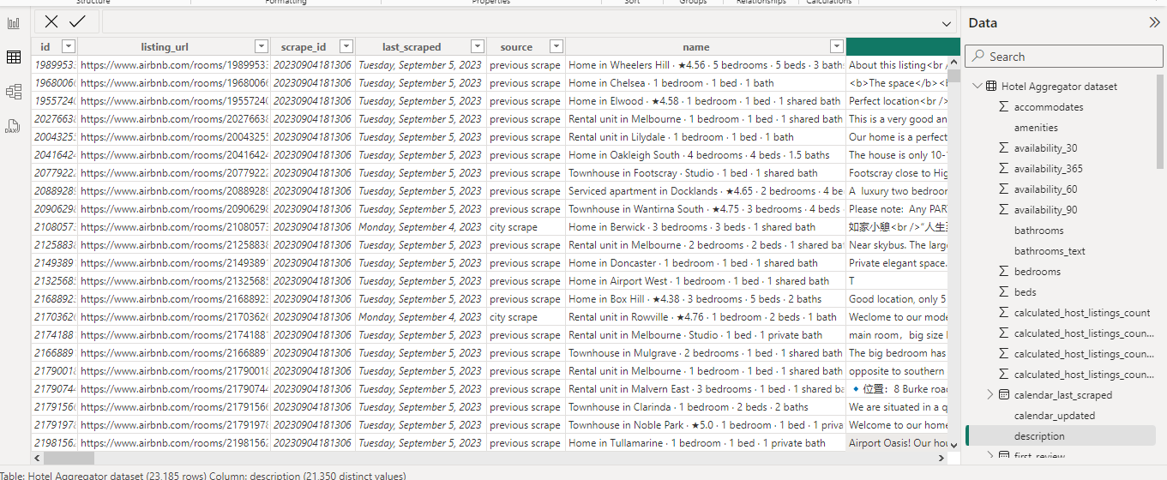
DATA SET OVERVIEW

Slide 4

DATASET DESCRIPTION
1. id: Unique identifier for each listing.
2. listing_url: URL of the listing on the hotel aggregator platform.
3. scrape_id: Identifier for the data scraping event.
4. last_scraped: Date of the last data scrape.
5. source: Source of the listing information.
6. name: Name of the listing.
7. description: Description of the listing.
8. neighborhood_overview: Overview of the neighborhood where the listing is located.
9. picture_url: URL of the listing's picture.
10. host_id: Unique identifier for the host.
11. ... (and many more columns capturing details about hosts, location, property type, room details, amenities, pricing, availability, reviews, and other relevant information)

Slide 5

OBJECTIVES
1. Geographical Insights: - Visualize the distribution of listings on a map to identify popular neighborhoods. - Explore the geographical concentration of listings and host locations.
2. Pricing and Availability Analysis: - Analyze pricing trends based on property types, room types, and accommodation capacity. - Investigate the availability of listings over time and identify peak periods.
3. Host Performance: - Evaluate host characteristics, including superhost status, response times, and verification methods. - Explore correlations between host attributes and listing performance.
4. Review Scores and Guest Satisfaction: - Examine review scores and their impact on overall listing performance. - Identify areas for improvement based on specific review categories.
5. Property Type and Room Analysis: - Analyse the distribution of property types and room types. - Explore trends in the popularity of specific accommodation setups.

Slide 6
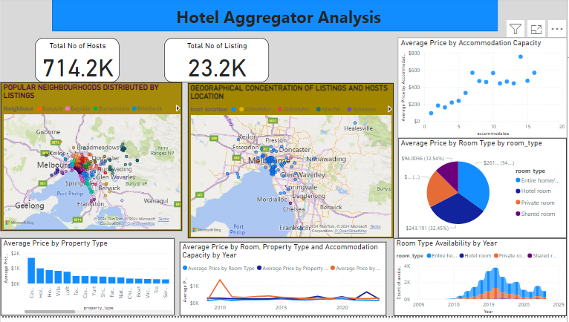
GEOGRAPHICAL INSIGHTS/PRICING AND AVAILABILTY ANALYSIS

Slide 7
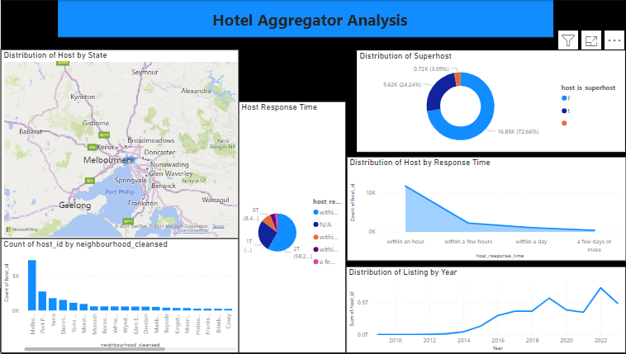
HOST PERFORMANCE

Slide 8
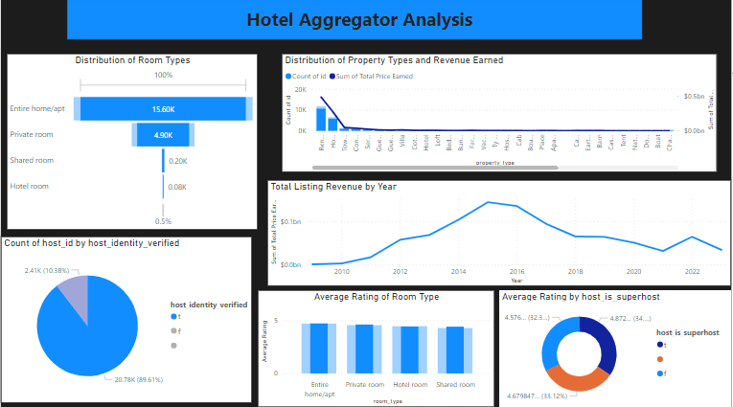
REVIEW SCORES AND GUEST SATISFACTION/PROPERTY TYPE AND ROOM ANALYSIS

Slide 9

RECOMMENDATIONS/INSIGHTS
Melbourne happens to be the most popular host location.
Casa-particular is the most expensive property type while serviced apartment is the cheapest.
Shared room is the most affordable room type.
The demand for entire room type increased from 2015 to 2016, but experienced decreasing and fluctuating demand after 2016.
Host response although above average should be improved on.
Total revenue also declined after 2016 which could have been as a result of declined availability, so availability should also be worked on.

Slide 10

THANK YOU

